Slide 1

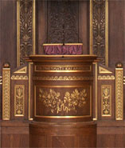
Parallel and Scalable Sparse Basic Linear Algebra Subprograms Weifeng Liu Niels Bohr Institute, University of Copenhagen, Denmark

Slide 2
Outline of the PhD Defense
Faculty of Science
Background
What are Sparse Matrix and Sparse Basic Linear Algebra Subprograms (BLAS)?
Why Sparse BLAS are Important?
Challenges
Indirect Addressing
Selection of Basic Primitives
Data Decomposition, Load Balancing and Scalability
Sparse Output of Unknown Size
Contributions
The CSR5 Format for Sparse Matrix-Vector Multiplication (ICS ‘15)
A Framework for Sparse Matrix-Matrix Multiplication on GPUs (IPDPS ‘14, JPDC)
Speculative Segmented Sum for SpMV on Heterogeneous Processors (PARCO)
ad-Heap Data Structures (GPGPU-7 workshop)
Sparse Representation in Computer Vision (BMVC ‘15)

Slide 3
Background Matrix & Sparse Matrix & Sparse Basic Linear Algebra Subprograms (Sparse BLAS)
Faculty of Science

Slide 4
Background - Matrix (dense)
A matrix is a group of numbers/symbols organized in a rectangular area.
columns
0
12
0
10
0
1
0
4
0
2
0
3
0
9
0
5
rows
0
16
0
6
0
5
0
8
0
4
0
3
0
15
0
6
A
(4x4)
dense

Slide 5
Background - Sparse Matrix
If the majority of entries in a matrix are zeros, we can store the matrix by using a sparse representation that only records nonzero entries.
0
0
0
1
0
0
1
row index =
0
1
1
3
3
3
0
2
0
3
0
0
0
2
0
3
column index =
2
0
1
0
2
3
0
0
0
0
0
4
0
0
5
0
6
0
4
0
5
0
6
value =
0
1
0
2
0
3
0
4
0
5
0
6
A
(4x4)
dense
A
(4x4)
nnzA = 6
A (a sparse representation)
(4x4)
nnzA = 6

Slide 6
Backgroud - BLAS L1. Vector-Vector
Example: a = x^{T}x
Multiply a sparse vector x by its transpose, obtain a scalar a.
x
0
a
=
0
b
0
a
0
b
0
d
a²+b²+d²
0
d
x^{T}
(1x4)
nnz = 3
x
(4x1)
nnz = 3
a
(1x1)
scalar

Slide 7
Background - BLAS L2. Matrix-Vector
Example: y = Ax
Multiply a sparse matrix A by a dense vector x, obtain a dense vector y.
0
1
x
0
a
=
1c
0
2
0
3
0
b
2a+3b
0
c
0
0
4
0
5
0
6
0
d
4a+5c+6d
A
(4x4)
nnzA = 6
x
(4x1)
dense
y
(4x1)
dense

Slide 8
Background - BLAS L3. Matrix-Matrix
Example: C = AB
Multiply a sparse matrix A by a sparse matrix B, obtain a sparse matrix C.
0
1
x
0
a
=
0
1d
1e
0
2
0
3
0
b
0
c
0
3b
0
3c
2a
0
d
0
e
0
4
0
5
0
6
0
f
0
5d
0
6f
4a+5e
A
(4x4)
nnzA = 6
B
(4x4)
nnzB = 6
C
(4x4)
nnzC = 8

Slide 9
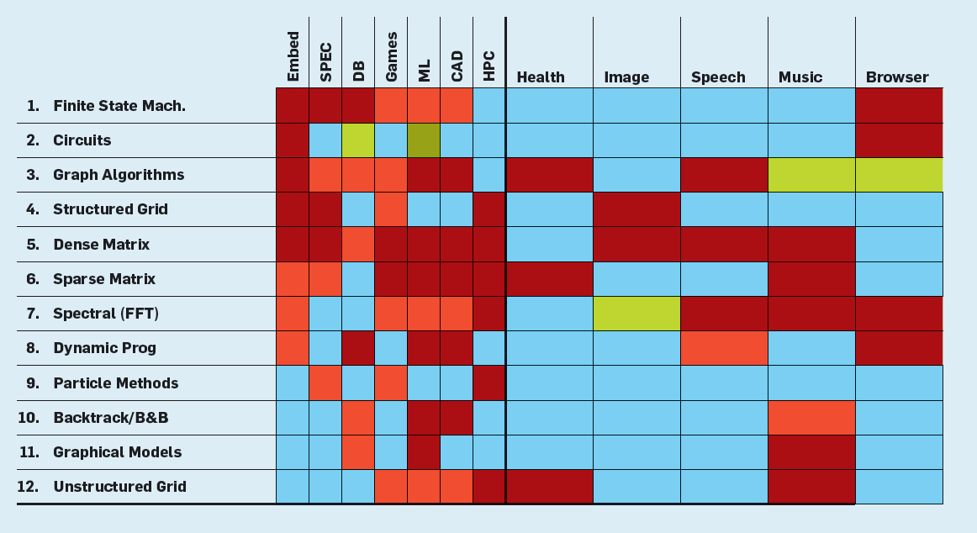
Background – Why Sparse BLAS?
Krste Asanovic, Rastislav Bodik, James Demmel, Tony Keaveny, Kurt Keutzer, John Kubiatowicz, Nelson Morgan, David Patterson, Koushik Sen, John Wawrzynek, David Wessel, and Katherine Yelick. 2009. A view of the parallel computing landscape. Commun. ACM 52, 10 (October 2009), 56-67.

Slide 10
Background – Why Sparse BLAS?
A statistics at the National Center for Supercomputing Applications (NCSA),
University of Illinois at Urbana-Champaign. Slide from Prof. Wen-mei W. Hwu

Slide 11
Four Challenges 1. Indirect Addressing & 2. Selection of Basic Primitives & 3. Data Decomposition, Load Balancing and Scalability & 4. Sparse Output of Unknown Size
Faculty of Science

Slide 12
Challenge – Indirect Addressing
Randomly accessing an entry in a dense matrix is trivial.
But the same operation for a sparse matrix is complex and inefficient.
0
12
0
10
0
1
0
4
0
0
0
1
0
row index =
0
1
1
3
3
3
0
2
0
3
0
9
0
5
0
2
0
3
0
0
column index =
2
0
1
0
2
3
0
16
0
6
0
5
0
8
0
0
0
0
0
4
0
3
0
15
0
6
0
4
0
0
5
0
6
value =
0
1
0
2
0
3
0
4
0
5
0
6
dense
sparse
sparse representation
This thesis does not focus on this challenge,
which is mostly considered by memory subsystems.

Slide 13
Challenge – Basic Primitives
P
Using an example from SpGEMM, because of the compressed sparse format, the result nonzeros are “inserted” into C, but not “added” to predictable locations of C.
0
4a
insert to column 3
0
4a
0
5d
0
=
4a
0
1
0
a
insert to column 1
x
0
5d
0
2
0
3
0
b
0
c
0
5d
0
4a
=
insert to column 3
4a+5e
0
5e
0
=
d
0
e
0
5d
4a+5e
0
x
insert to column 2
6f
0
6f
0
4
0
5
0
6
0
f
=
x
0
1d
1e
A
B
x
0
3b
0
3c
2a
Parallel hash tables?
Not truly fast
0
5d
0
6f
4a+5e
C

Slide 14

Challenge – Scalability
S
p1
0
1
x
0
a
p1
0
1
0
2
0
3
0
b
0
c
p2
0
2
0
3
p2
0
d
0
e
p3
0
4
0
5
0
6
0
f
p4
0
4
0
5
0
6
A
B
A
1D partition
on A
p1
p2
0
even partition
on A
Accessing
on B
1
Imbalanced
0
2
0
3
Balanced
for SpMV
Imbalanced
p3
p4
2D partition
on A
0
Overall – imbalanced
for SpGEMM
4
0
5
0
6
Imbalanced
A

Slide 15
Challenge – Output of Unknown Size
U
In SpGEMM, the number of nonzeros in C is unknown in advance. Thus it’s not possible to pre-allocate C precisely.
One method is to compute boolean SpGEMM, get nnzC, allocate memory and run the “real” SpGEMM.
0
1
x
0
a
=
?
0
2
0
3
0
b
0
c
0
d
0
e
0
4
0
5
0
6
0
f
A, nnzA = 6
B, nnzB = 6
nnzC = ?
C,
One SpGEMM for Two!
Expensive
T
x
T
=
T
T
Allocate
space of size nnzC
1
x
a
T
T
T
T
T
T
T
2
3
b
c
T
T
d
e
T
T
T
T
T
T
T
4
5
6
f

Slide 16
Contributions (Selected) The CSR5 Format for SpMV & A Framework for SpGEMM on GPUs
Faculty of Science

Slide 17
Contributions (Selected) The CSR5 Format for SpMV & A Framework for SpGEMM on GPUs
Faculty of Science

Slide 18
Sparse Matrix-Vector Multiplication
Multiply a sparse matrix A by a dense vector x, obtain a dense vector y.
0
1
x
0
a
=
1c
0
2
0
3
0
b
2a+3b
0
c
0
0
4
0
5
0
6
0
d
4a+5c+6d
A
(4x4)
nnzA = 6
x
(4x1)
dense
y
(4x1)
dense
Storage format of A is crucial for SpMV throughput.

Slide 19
Storage format – Diagonal (DIA)
Store nonzero entries on diagonals.
0
1
0
2
0
3
0
4
diagonal (0) =
0
1
0
2
0
3
0
4
0
5
0
0
6
5
0
6
A
(6x6)
nnzA = 6
A (in DIA format)
(6x6)
nnzA = 6

Slide 20
Storage format – Diagonal (DIA)
Store nonzero entries on diagonals.
0
1
0
7
0
12
0
2
0
8
diagonal (-1) =
0
0
12
0
13
0
14
0
15
0
16
0
13
0
3
0
9
diagonal (0) =
0
1
0
2
0
3
0
4
0
5
0
6
0
14
0
4
0
10
diagonal (+1) =
0
7
0
8
0
9
0
10
0
0
11
0
15
0
5
0
11
0
16
0
6
A
(6x6)
nnzA = 16
A (in DIA format)
(6x6)
nnzA = 16

Slide 21
Storage format – Diagonal (DIA)
Store nonzero entries on diagonals.
diagonal (-2) =
0
0
0
0
18
0
0
0
1
0
7
0
12
0
2
0
8
diagonal (-1) =
0
0
12
0
13
0
14
0
15
0
16
0
18
0
13
0
3
0
9
diagonal (0) =
0
1
0
2
0
3
0
4
0
5
0
6
0
14
0
4
0
10
0
17
diagonal (+1) =
0
7
0
8
0
9
0
10
0
0
11
0
15
0
5
0
11
0
16
0
6
diagonal (+2) =
0
0
0
0
0
0
17
A
(6x6)
nnzA = 18
A (in DIA format)
(6x6)
nnzA = 18

Slide 22
Storage format – ELLPACK (ELL)
Store nonzero entries and their column indices.
column index =
value =
0
1
0
7
0
1
-
-
0
1
0
7
0
0
0
12
0
2
0
8
0
1
2
-
0
12
0
2
0
8
0
0
18
0
13
0
3
0
9
0
1
2
3
0
18
0
13
0
3
0
9
0
14
0
4
0
10
0
17
2
3
4
5
0
14
0
4
0
10
0
17
0
15
0
5
0
11
3
4
5
-
0
15
0
5
0
11
0
0
16
0
6
4
5
-
-
0
16
0
6
0
0
A
(6x6)
nnzA = 18
A (in ELL format)
(6x6)
nnzA = 18

Slide 23
Storage format – ELLPACK (ELL)
Store nonzero entries and their column indices.
column index =
value =
-
-
-
-
0
0
0
0
-
-
-
-
0
0
0
0
0
18
0
13
0
3
0
9
0
1
2
3
0
18
0
13
0
3
0
9
-
-
-
-
0
0
0
0
-
-
-
-
0
0
0
0
-
-
-
-
0
0
0
0
A
(6x6)
nnzA = 4
A (in ELL format)
(6x6)
nnzA = 4

Slide 24
Storage format – Coordinate (COO)
Store nonzero entries and their row and column indices.
0
1
0
8
row index =
0
1
2
2
2
2
5
5
0
18
0
13
0
3
0
9
column index =
0
2
0
1
2
3
4
5
value =
0
1
0
8
0
18
0
13
0
3
0
9
0
16
0
6
0
16
0
6
A
(6x6)
nnzA = 8
A (in COO format)
(6x6)
nnzA = 8

Slide 25
Storage format – Compressed Sparse Row (CSR)
Store a row pointer, nonzero entries and their column indices.
0
1
row pointer =
0
1
2
6
6
6
8
0
8
0
18
0
13
0
3
0
9
column index =
0
2
0
1
2
3
4
5
value =
0
1
0
8
0
18
0
13
0
3
0
9
0
16
0
6
0
16
0
6
A
(6x6)
nnzA = 8
A (in CSR format)
(6x6)
nnzA = 8

Slide 26
CSR-based SpMV
assign a row block (multiple rows) to one core.
0
1
Core 0
0
8
Core 1
Possibly
imbalanced
computation
0
18
0
13
0
3
0
9
Core 2
Core 3
Core 4
0
16
0
6
Core 5
A
(6x6)
nnzA = 8

Slide 27
The CSR5 Storage Format (this work)
Faculty of Science

Slide 28
CSR5: Tiling
column index =
Core 0
Core 1
Tile 0
for
core 0
Tile 1
for
core 1
0
7
1
6
5
2
6
2
6
7
2
1
2
7
0
3
7
3
3
3
3
1
1
4
0
4
0
1
0
2
0
3
0
4
0
5
6
0
4
3
1
5
1
5
0
1
0
2
value =
0
1
0
5
0
2
0
6
0
3
0
2
0
6
0
3
0
7
0
8
0
1
0
2
0
3
0
4
0
5
0
6
0
7
0
2
0
1
0
3
0
7
0
1
0
3
0
7
0
4
0
1
0
2
0
3
0
3
0
2
0
4
0
1
0
2
0
4
0
1
0
5
0
1
0
2
0
4
0
1
0
5
0
2
0
1
0
5
0
2
0
6
S
0
1
0
2
0
3
0
4
0
5
0
6
0
7
bit-flag =
0
1
0
2
0
3
0
4
0
5
0
6
0
7
0
8
T
Evenly assign matrix to
compute units,
thus load balanced and
insensitive to sparsity structure
F
F
F
T
F
F
F
A
(8x8)
nnzA = 34
F
T
F
F
T
F
F
F
F
F
F
T
F
F
T
F
F
T
F
F
T
F
F
F

Slide 29
Using tile-wise transposed CSR data
value (CSR5) =
0
1
0
5
0
2
0
6
0
3
0
2
0
6
0
3
0
7
0
8
0
1
0
2
0
3
0
4
0
5
0
2
0
1
0
3
0
7
0
1
0
3
0
7
0
4
0
1
0
2
0
3
0
2
0
4
0
1
0
2
0
4
0
1
0
5
0
4
0
1
0
5
0
2
0
1
0
5
0
2
0
6
0
1
0
2
0
3
0
4
0
5
0
6
0
7
0
1
0
2
0
3
value (CSR) =
0
1
0
2
0
1
0
2
0
3
0
4
0
3
0
1
0
2
0
1
0
7
0
8
0
1
0
2
0
3
0
4
0
5
0
6
0
7
0
5
0
1
0
2
0
1
0
2
0
3
0
4
0
5
0
1
0
2
0
3
0
4
0
5
0
6
0
7
0
8
Directly use CSR data,
thus space-effcient and
fast format conversion
from CSR
0
2
0
3
0
4
0
5
0
6
0
7
0
1
0
2
A
(8x8)
nnzA = 34
0
6
0
7
0
1
0
2
0
3
0
4
0
5
0
6

Slide 30
CSR5: Tile Pointer array
tile pointer =
0
0
4
7
8
1
0
2
0
3
0
4
0
5
0
-0
1
0
2
0
1
0
2
0
3
0
4
0
5
0
6
0
7
value =
0
1
0
2
0
3
0
1
0
5
0
2
0
6
0
3
0
2
0
6
0
3
0
7
0
8
0
1
0
2
0
2
0
1
0
3
0
7
0
1
0
3
0
7
0
4
0
1
0
2
0
3
0
4
0
5
0
6
0
7
0
3
0
2
0
4
0
1
0
2
0
4
0
1
0
5
0
1
0
2
0
3
0
4
0
5
0
6
0
7
0
8
0
4
0
1
0
5
0
2
0
1
0
5
0
2
0
6
A
(8x8)
nnzA = 34
tile pointer[i] is the row index of the 1st entry of tile i.
set tile pointer[i] to -tile pointer[i], if at least one empty row is in tile i.

Slide 31
CSR5: Tile Descriptor information
tile pointer =
0
-0
4
7
8
1
0
2
0
3
0
4
0
5
+
+
0
1
0
2
y offset =
0
1
3
3
0
3
3
4
0
1
0
2
0
3
0
4
0
5
0
6
0
7
value =
0
1
0
2
0
3
0
1
0
5
0
2
0
6
0
3
0
2
0
6
0
3
0
7
0
8
0
1
0
2
0
2
0
1
0
3
0
7
0
1
0
3
0
7
0
4
0
1
0
2
0
3
0
4
0
5
0
6
0
7
0
3
0
2
0
4
0
1
0
2
0
4
0
1
0
5
0
1
0
2
0
3
0
4
0
5
0
6
0
7
0
8
0
4
0
1
0
5
0
2
0
1
0
5
0
2
0
6
A
(8x8)
nnzA = 34
add up tile pointer[i] and y offset[i][j]; let column j of tile i knows where to store its products,
Tile 0 needs extra work, see next slide.

Slide 32
More Details
The paper has details of
How to decide auto-tuned tile size,
How to correct indices in y for tiles with empty rows,
How to generate tile pointer and tile descriptor in parallel.

Slide 33
Why it’s called CSR5?
Because this format is composed
of 5 groups of information.

Slide 34
The CSR5-based SpMV
Faculty of Science

Slide 35
CSR5-based SpMV (a tile example)
coloring by bit-flag info
G
R₁
R₂
R₃
G
R₁
R₂
R₃
0
self-sealed
G
G
G
Thread 0, or
SIMD lane 0
Thread 1, or
SIMD lane 1
Thread 2, or
SIMD lane 2
Thread 3, or
SIMD lane 3
B
R₁
sealed from top
R₂+R₃
R₃
0
G
G
G
R
sealed from bottom
B₃
B₁+R₁
B₂+R₂+R₃
R₃
B₃
B₁
B₂
B₁
B₂
0
B₃
y =
...
...

Slide 36
CSR5-based SpMV (cross-platform)
lock-step SIMD + scatter
fast segmented sum
through
prefix-sum scan primitive
(see paper for details)
G
R₁
R₂
R₃
R₁
R₂
R₃
0
G
G
G
Thread 0, or
SIMD lane 0
Thread 1, or
SIMD lane 1
Thread 2, or
SIMD lane 2
Thread 3, or
SIMD lane 3
R₁
R₂+R₃
R₃
0
P
G
G
G
B₃
B₁+R₁
B₂+R₂+R₃
R₃
B₃
B₁
Easy to implement on
CPUs, GPUs and Xeon Phi,
thus cross-platform
B₂
B₁
B₂
0
B₃
y =
...
...

Slide 37
Experimental Results
Faculty of Science

Slide 38
Experiment platforms
Intel Xeon E5-2667 v3 (dual-socket), 2x 8 Haswell cores @ 3.2 GHz, 2x 68.3 GB/s Bandwidth. (1) MKL-CSR [‘15], (2) BiCSB [‘11], (3) pOSKI [‘12], (4) CSR5.
nVidia GeForce GTX 980, 2048 CUDA cores @ 1.13 GHz, 224 GB/s bandwidth. (1)cuSPARSE/CUSP-CSR [‘15], (2)cuSPARSE/CUSP-HYB [‘15], (3) BRC [ICS ‘14], (4) ACSR [SC ‘14], (5) CSR5.
AMD Radeon R9 290X, 2816 Radeon cores @ 1.05 GHz, 345.6 GB/s bandwidth. (1) CUSP-CSR [‘15], (2) CSR-Adaptive [SC ‘14], (3) CSR5.
Intel Xeon Phi 5110p, 60 x86 cores @ 1.05 GHz, 320 GB/s bandwidth. (1) MKL-CSR [‘15], (2) ESB [ICS ‘13], (3) CSR5.

Slide 39
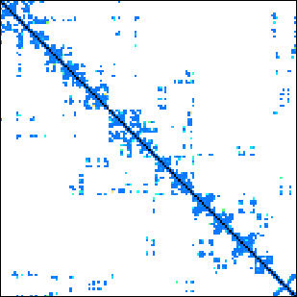
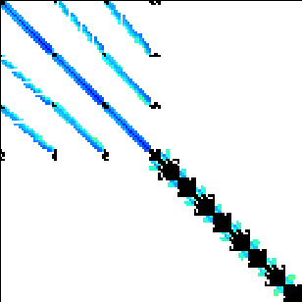



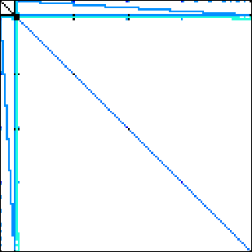

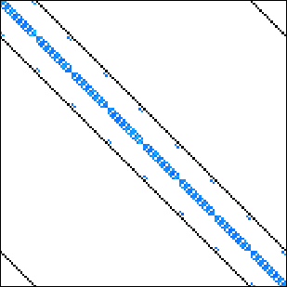

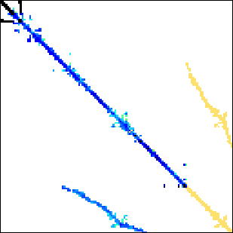
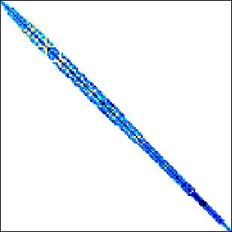


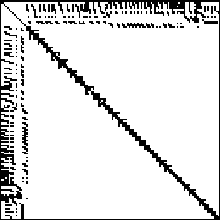
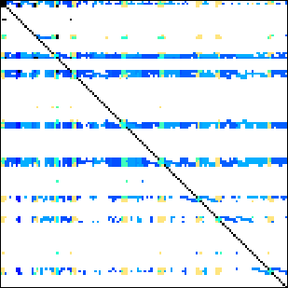
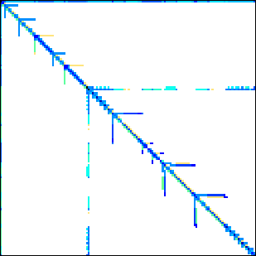


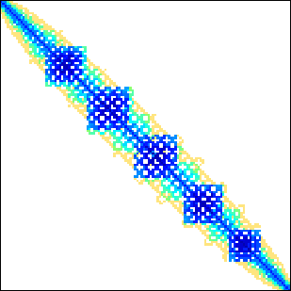
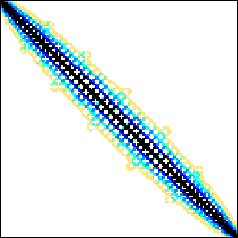
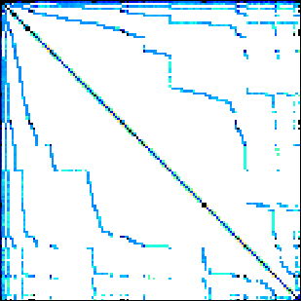

Benchmark suite
24 matrices downloadable from the University of Florida sparse matrix collection.
Dense
Protein
FEM/Spheres
FEM/Cantilever
Wind Tunnel
Webbase
LP
Circuit5M
eu-2005
QCD
Epidemiology
FEM/Harbor
FEM/Ship
Economics
in-2004
mip1
ASIC_680k
dc2
FEM/Accelerator
Circuit
Ga41As41H72
Si41Ge41H72
FullChip
ins2
14 regular matrices
10 irregular matrices

Slide 40
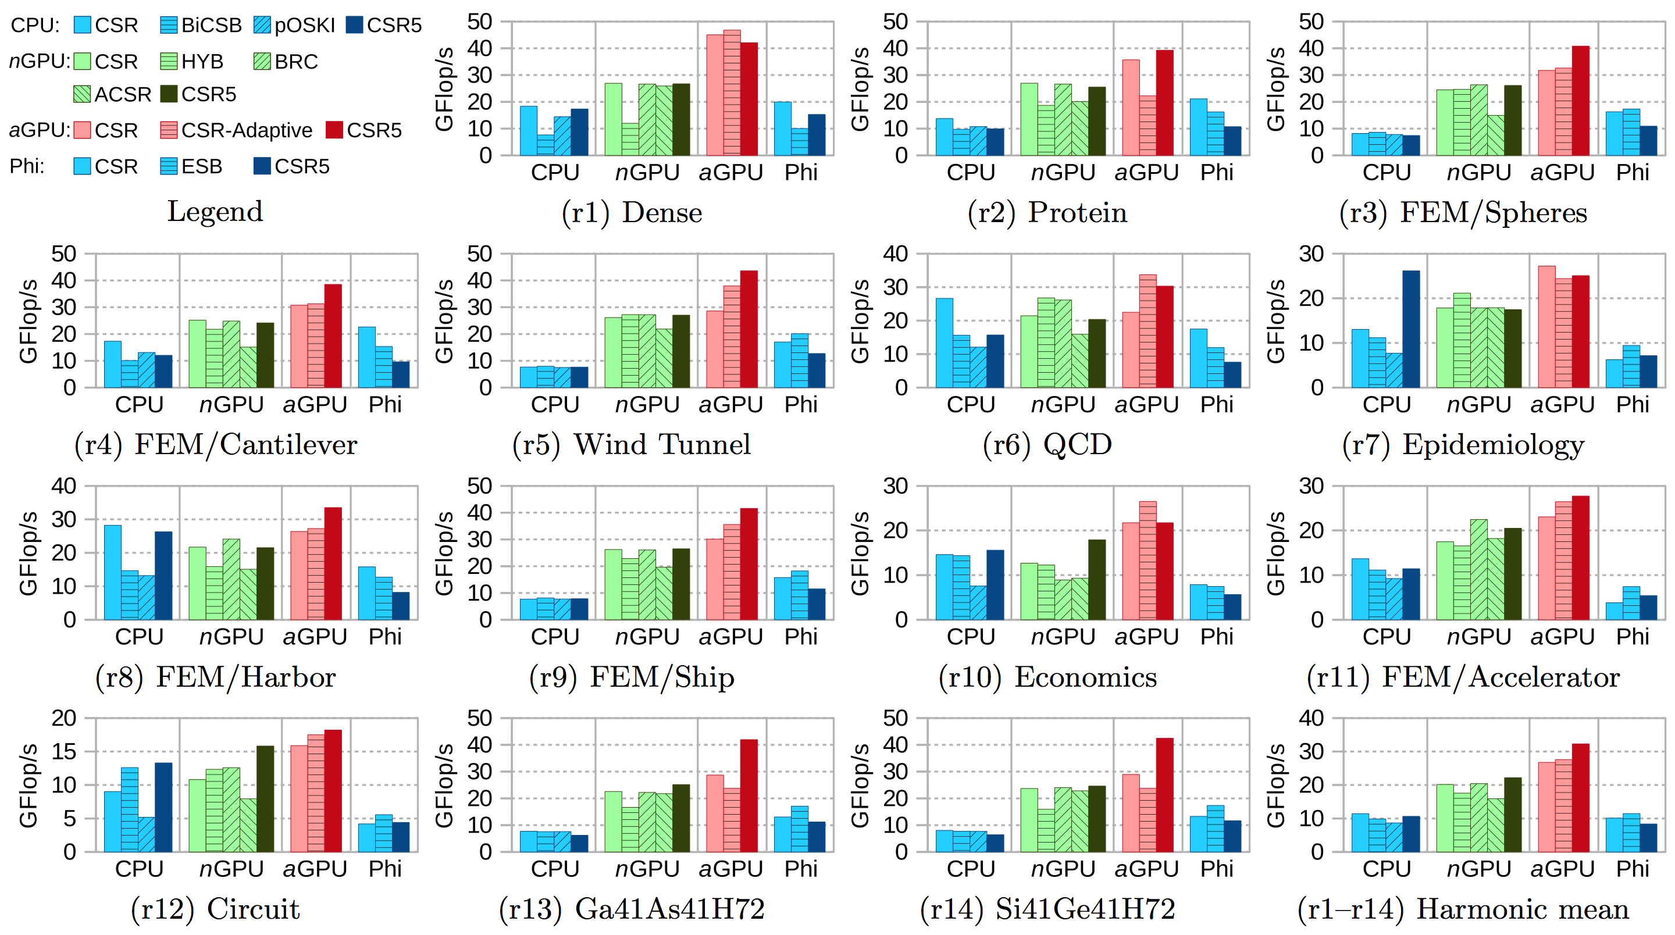
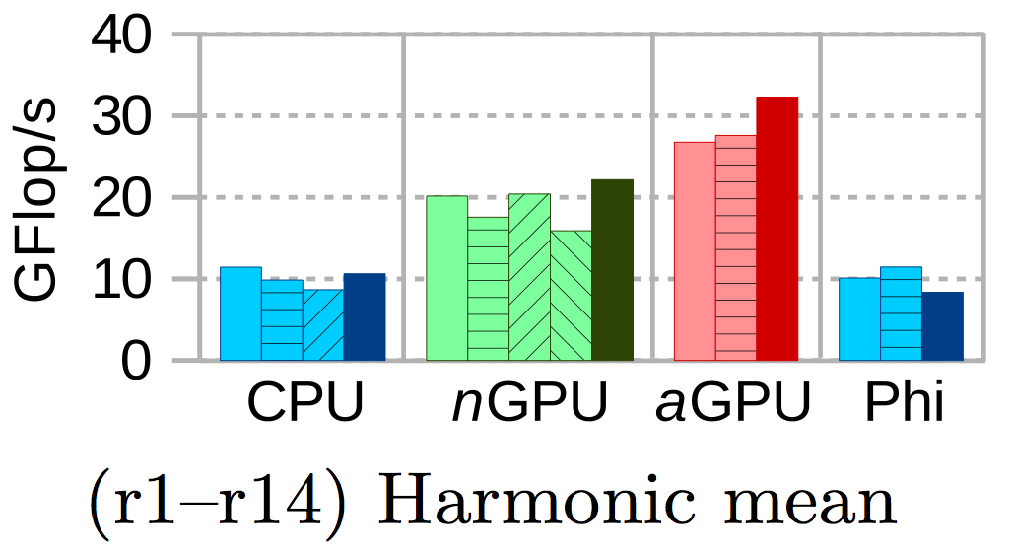
Throughput (FP64) – regular matrices

Slide 41
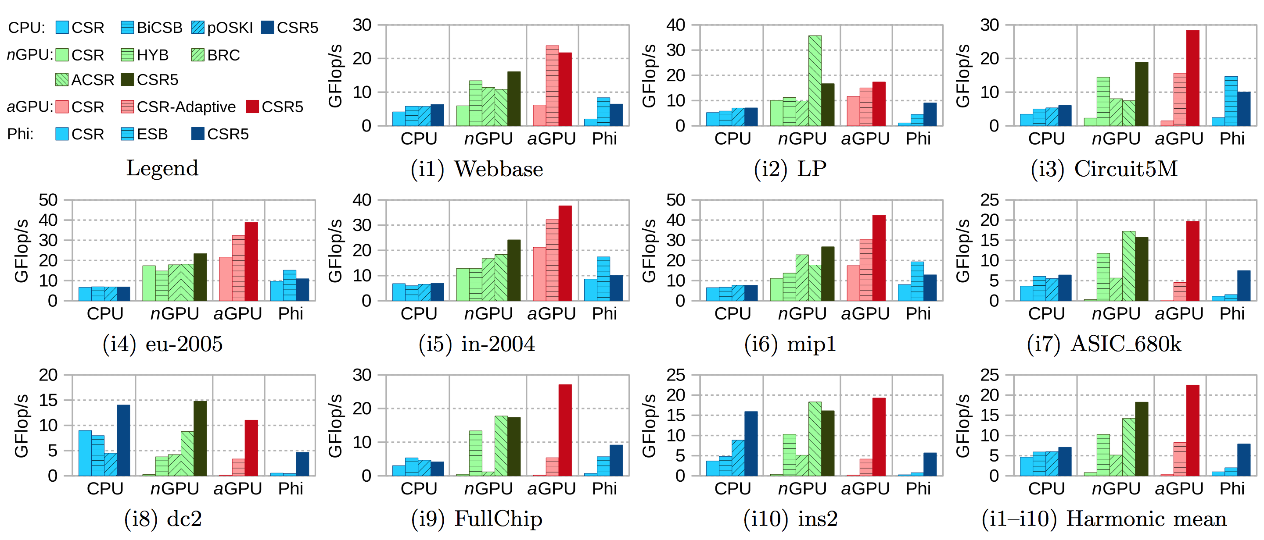
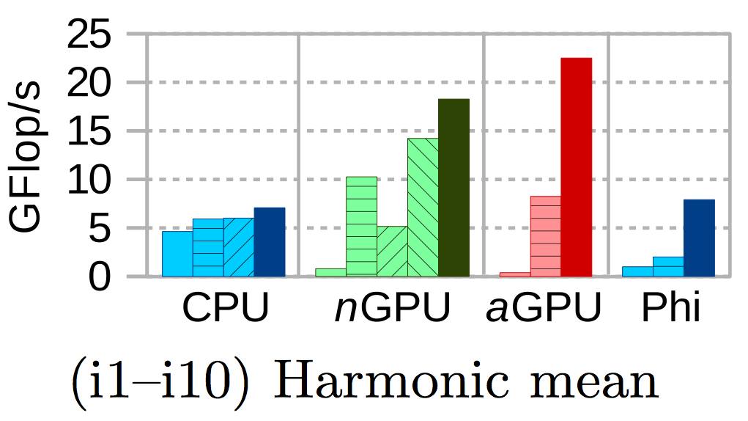
Throughput (FP64) – irregular matrices

Slide 42
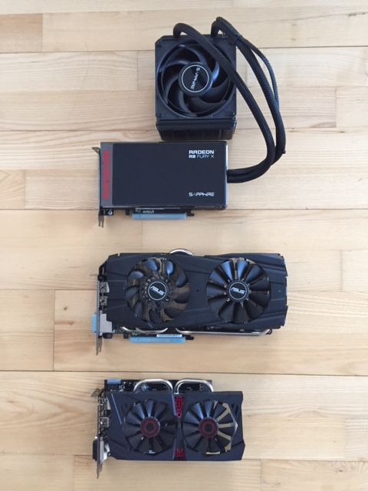
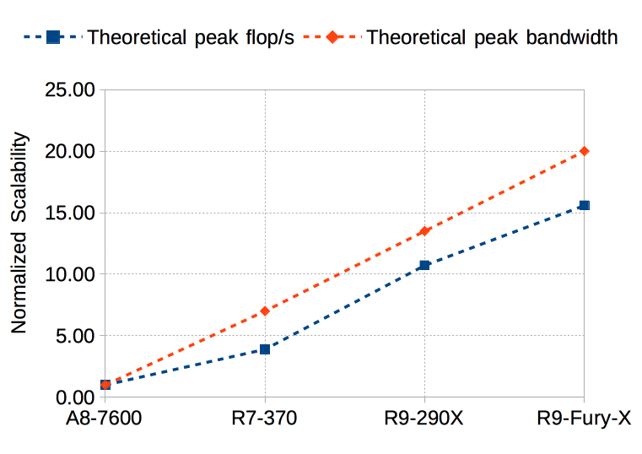
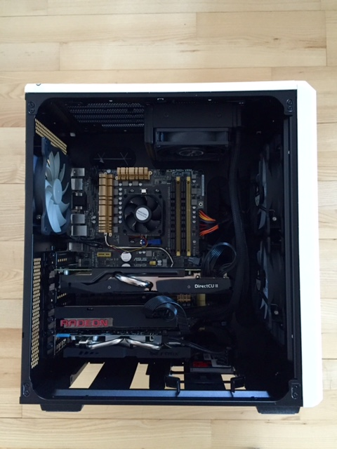
Scalability - Testbed
A8-7600 | R7-370 | R9-290X | R9-Fury-X
SP Peak (Mflop/s) 552.00 2150.00 5913.00 8601.00
Normalized 1.00 3.89 10.71 15.58
bandwidth (GB/s) 25.60 179.20 345.60 512.00
Normalized 1.00 7.00 13.50 20.00
R9-Fury-X
R9-290X
A8-7600
R7-370

Slide 43
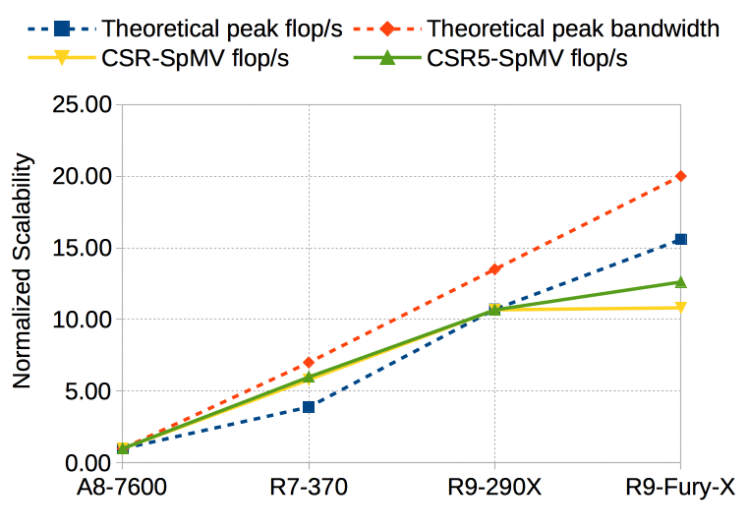
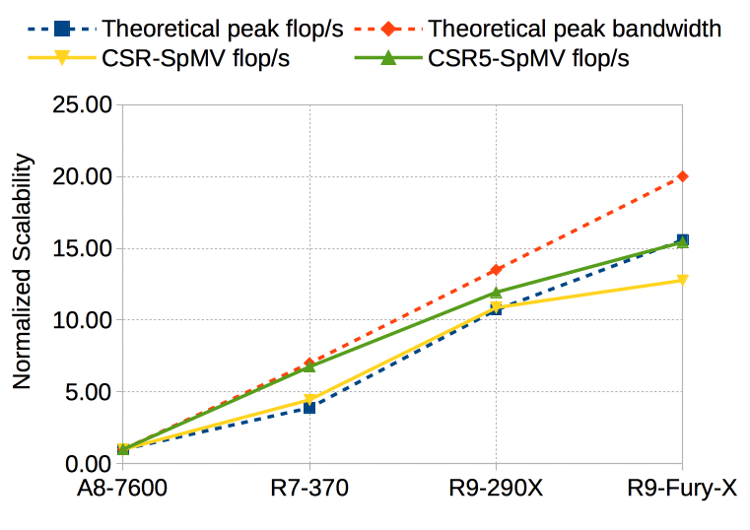
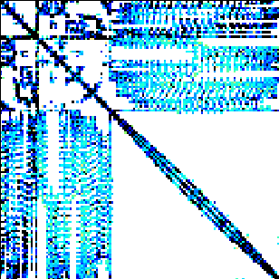
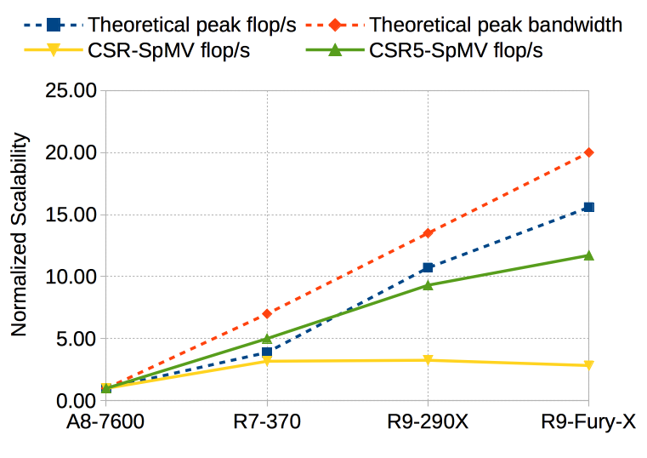
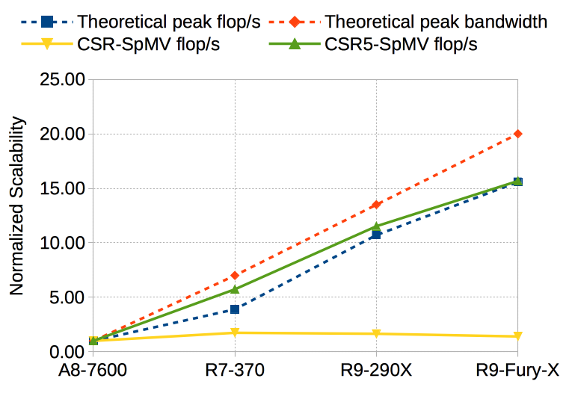
Scalability - Results
S
Dense
audikw_1
Webbase
Circuit5M

Slide 44
Publication
W. Liu, B. Vinter. "CSR5: An Efficient Storage Format for Cross-Platform Sparse Matrix-Vector Multiplication". 29th ACM International Conference on Supercomputing (ICS ’15).

Slide 45
Contributions (Selected) The CSR5 Format for SpMV & A Framework for SpGEMM on GPUs
Faculty of Science

Slide 46
Sparse GEMM (SpGEMM) - Basics
Multiply a sparse matrix A by a sparse matrix B, obtain a result sparse matrix C.
0
1
x
0
a
=
0
1d
1e
0
2
0
3
0
b
0
c
0
3b
0
3c
2a
0
d
0
e
0
4
0
5
0
6
0
f
0
5d
0
6f
4a+5e
A
(4x4)
nnzA = 6
B
(4x4)
nnzB = 6
C
(4x4)
nnzC = 8

Slide 47
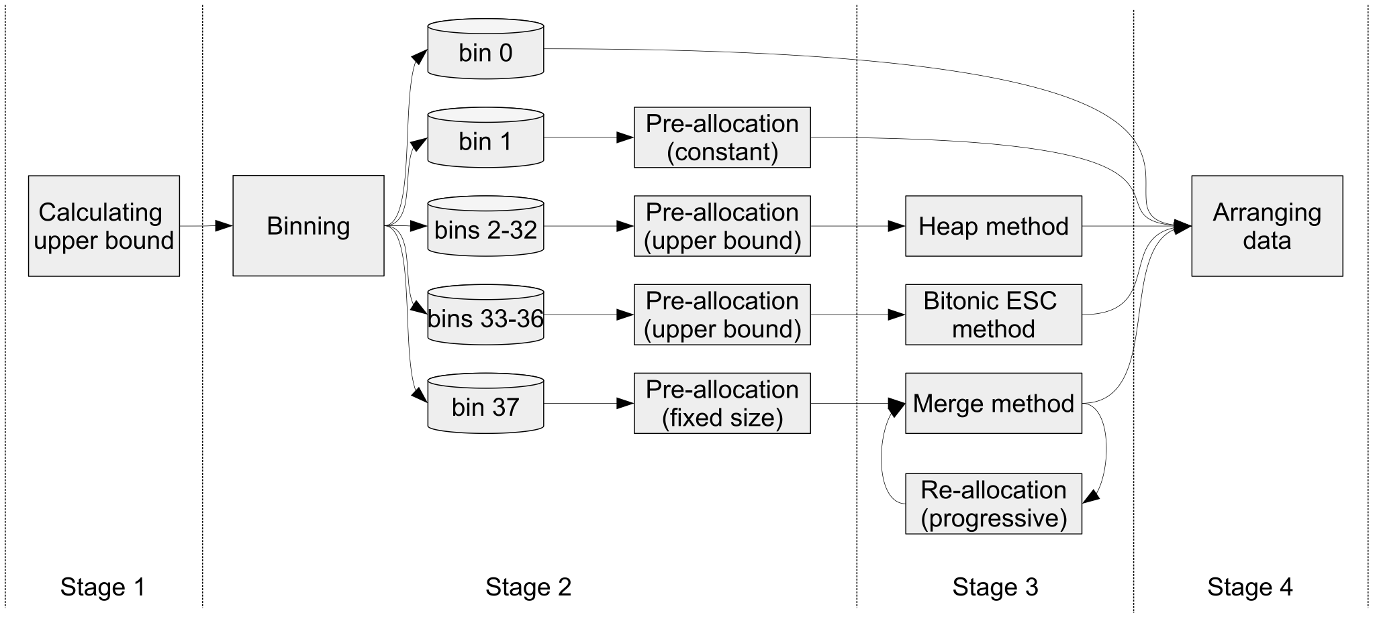
Our 4-stage SpGEMM Framework

Slide 48
Framework Stage 1

Slide 49
Stage 1. Upper bound of nnzC
To calculate the upper bound of nnz of each row of C, for each nonzero in the row of A, sum up nnz of corresponding rows (with the same column ids of the nonzero of A) of B.
0
1
x
0
a
nnz(c_{0*})_{ub} = 2
0
2
0
3
0
b
0
c
nnz(c_{1*})_{ub} = 1
+ 2 = 3
0
d
0
e
nnz(c_{2*})_{ub} = 0
0
4
0
5
0
6
0
f
nnz(c_{3*})_{ub} = 1
+ 2
+ 1 = 4
A
B
Q: Should we pre-allocate a C of the upper bound size?
A: No. NnzC_{ub} may be very large,
so we do not pre-allocate it in this stage.

Slide 50
Framework Stage 2

Slide 51
Stage 2. Binning
According to nnz_{ub} of each row of C, we group (permutate) all rows of C to 38 bins (in 5 bin groups).
nnz(c_{0*})_{ub} = 2
nnz(c_{1*})_{ub} = 3
nnz(c_{2*})_{ub} = 0
nnz(c_{3*})_{ub} = 4
S
…
2
0
1
3
nnz(c_{i*})_{ub} = 0
nnz(c_{i*})_{ub} = 2
nnz(c_{i*})_{ub} = 4
nnz(c_{i*})_{ub} = 3
nnz(c_{i*})_{ub} = 32
nnz(c_{i*})_{ub} = 33-64
nnz(c_{i*})_{ub} = 65-128
nnz(c_{i*})_{ub} = 129-256
nnz(c_{i*})_{ub} = 257-512
nnz(c_{i*})_{ub} = 1
nnz(c_{i*})_{ub} > 512
b1
b2
b3
b4
b5
b33
b34
b35
b36
b37
b38

Slide 52
Stage 2. Memory pre-allocation
We calculate an initial size for C.
For bins 1-33, nnz = # of rows * binsize
e.g., bin 4 collectes 1 row, nnz = 1 * 3 = 3
For bins 34-37, nnz = # of rows * binsize_{ub}
e.g., bin 35 collectes 4 rows, nnz = nnz₁+ ... nnz₄
For bin 38, nnz = # of rows * 256
e.g. bin 38 collectes 8 rows, nnz = 8 * 256 = 2048
U
…
nnz(c_{i*})_{ub} = 0
nnz(c_{i*})_{ub} = 2
nnz(c_{i*})_{ub} = 4
nnz(c_{i*})_{ub} = 3
nnz(c_{i*})_{ub} = 32
nnz(c_{i*})_{ub} = 33-64
nnz(c_{i*})_{ub} = 65-128
nnz(c_{i*})_{ub} = 129-256
nnz(c_{i*})_{ub} = 257-512
nnz(c_{i*})_{ub} = 1
nnz(c_{i*})_{ub} > 512
b₁
b₂
b₃
b₄
b₅
b₃₃
b₃₄
b₃₅
b₃₆
b₃₇
b₃₈

Slide 53
Framework Stage 3

Slide 54
Stage 3. C is the goal!
1d
1e
3b
3c
2a
5d
6f
4a+5e
For bin 1 or bin 2, no computation is required.
For bins 3-33, a heap-based method is used. Each bin has a dedicated GPU kernel call.
For each GPU thread:
(1) collects all candidate nonzeros,
(2) establishs a binary max-heap on column indices,
(3) executes a heapsort-like operation to sort and fuse entries at a duplicate location.
Example. Row 3
column_index =
3
1
3
2
value =
P
0
4a
0
5d
S
0
5e
0
6f
Load balancing
is guaranteed,
since each GPU
thread has the
same amount of
work.
idx=3
val=4a
idx=3
val=5e
idx=2
val=6f
idx=1
val=5d
idx=2
val=6f
idx=3
val=5e
idx=2
val=6f
idx=1
val=5d
idx=1
val=5d
idx=1
val=5d
-
idx=3
val=4a
idx=3
val=4a+5e
idx=2
val=6f
idx=3
val=4a+5e
idx=1
val=5d
idx=2
val=6f
idx=3
val=4a+5e

Slide 55
Stage 3. C is the goal! (cont.)
1d
1e
3b
3c
2a
5d
6f
4a+5e
For bins 34-37, a bitonic sort based method is used. Each bin has a dedicated GPU kernel call.
For each GPU thread-group:
column_index =
3
1
3
2
(1) collects all candidate nonzeros,
(2) sorts them according to the column indices,
(3) identifies duplicate nonzeros, and scans to obtain final positions,
(4) compacts nonzeros at the same column location,
(5) obtains final nonzeros of the row.
value =
0
4a
0
5d
0
5e
0
6f
P
S
column_index =
1
2
3
Example. Row 3
3
value =
0
5d
0
6f
0
4a
0
5e
Load balancing
is naturally
guaranteed,
although each GPU
thread-group has
different amount
of work.
flag =
1
1
1
0
flag (scan) =
0
1
2
3
column_index =
1
2
3
3
value =
0
5d
0
6f
4a+5e
0
5e
column_index =
1
2
3
value =
0
5d
0
6f
4a+5e

Slide 56
Stage 3. C is the goal! (cont.)
1d
1e
3b
3c
2a
5d
6f
4a+5e
For bin 38, a merge-based method is used.
For each GPU thread-group:
(1) looks for duplicate locations through binary search,
(2) fuses values at the same position,
(3) copies the input sequence without duplicate entries to the result sequence,
(4) merge the two sequences through Merge Path algorithm and gets the new result sequence.
input sequence =
1
2
3
1
3
0
5d
0
6f
0
4a
0
5d
0
5e
Example. Row 3
P
result sequence =
3
S
4a+5e
Load balancing is naturally guaranteed.
U
If the pre-allocated space is not enough,
2x memory is allocated.
The old values are copied to new space.
The same merge operations continue.

Slide 57
Framework Stage 4

Slide 58
Stage 4. Arranging data
Now we know the precise size of nnzC, and can allocate a “real” C and copy nonzeros from the pre-allocated space to the final space.
U
pre-allocated C
final C

Slide 59
Experiment platforms
Intel Xeon E5-2630, six Sandy Bridge cores @ 2.3 GHz, 15 MB LL$, 4-channel memory, 42.6 GB/s Bandwidth. MKL v11.0.
nVidia GeForce GTX Titan Black, 2880 CUDA cores @ 889 MHz, 720 kB scratchpad, 336 GB/s bandwidth. cuSPARSE v6.5, CUSP v0.4.0, RMerge (Gremse et al., SIAM SISC ‘15) and bhSPARSE_CUDA (this work).
nVidia GeForce GTX 980, 2048 CUDA cores @ 1126 MHz, 1536 kB scratchpad, 224 GB/s bandwidth. cuSPARSE v6.5, CUSP v0.4.0, RMerge and bhSPARSE_CUDA.
AMD Radeon R9 290X, 2816 Radeon cores @ 1050 MHz, 2816 kB scratchpad, 345.6 GB/s bandwidth. bhSPARSE_OCL.

Slide 60


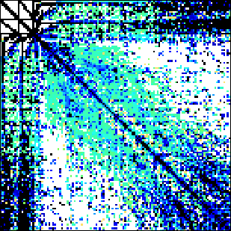

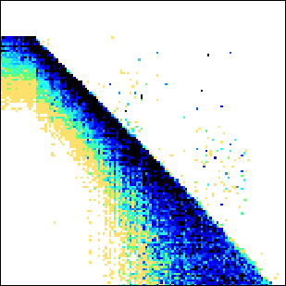

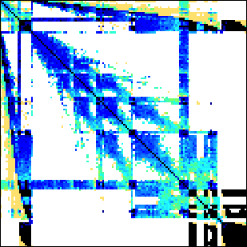
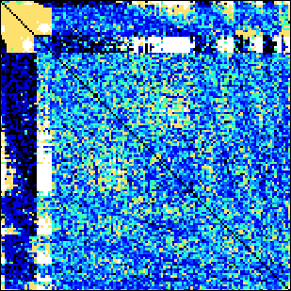
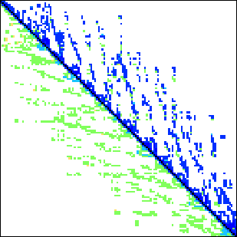

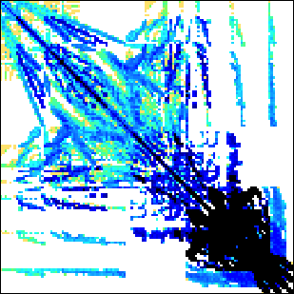
Benchmark suite
23 matrices downloadable from the University of Florida sparse matrix collection.
cant
filter3D
harbor
2cubes_sphere
hood
mario002
patents_main
scircuit
economics
pwtk
protein
accelerator
m133-b3
mono_500Hz
poisson3Da
webbase-1M
epidemiology
ship
spheres
cage12
majorbasis
offshore
QCD
Regular matrices
Irregular matrices with diverse structures

Slide 61
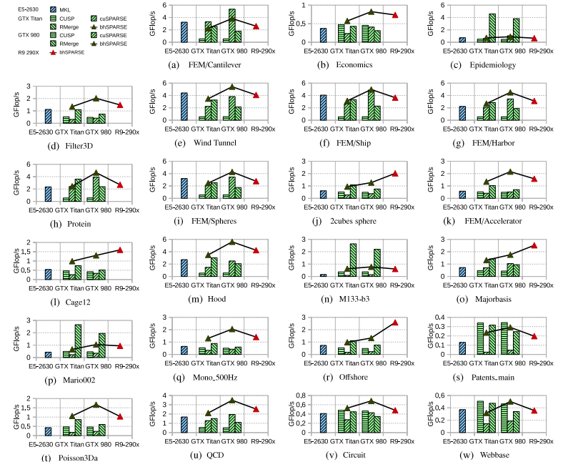
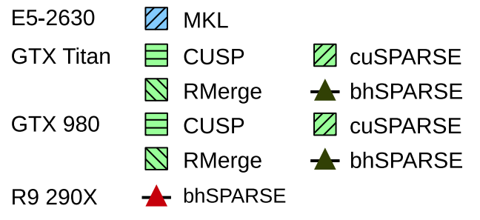
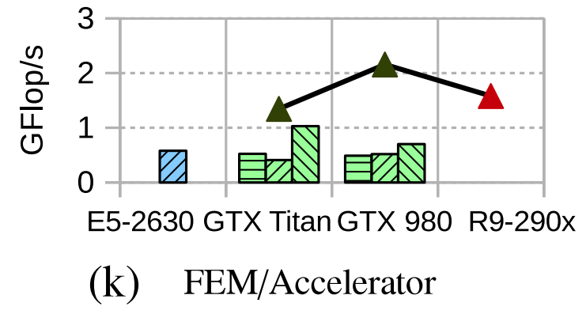
Comparison: C = A² (double percision)

Slide 62
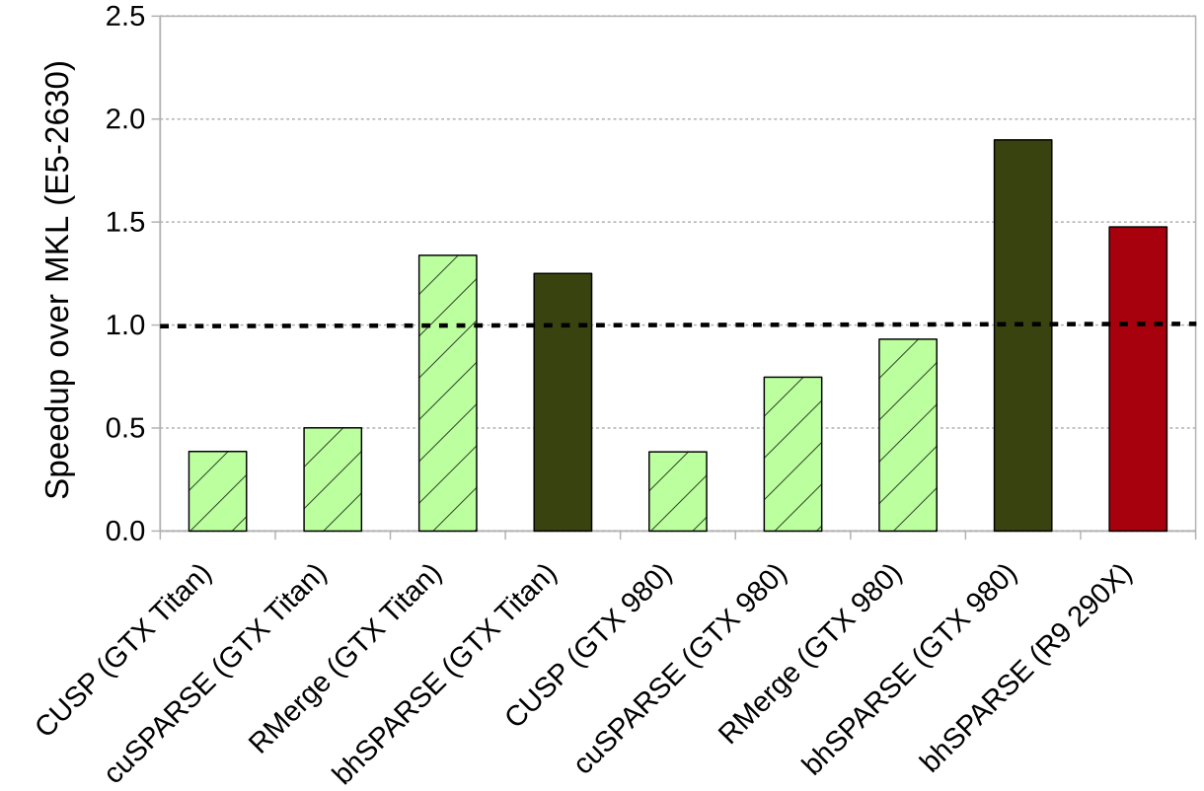
Har-mean: C = A² (double percision)
nVidia GTX Titan Black
Kepler
nVidia GTX 980
Maxwell
AMD
R9
290X
GCN
Speedups
over
6c Intel
E5-2630 CPU

Slide 63
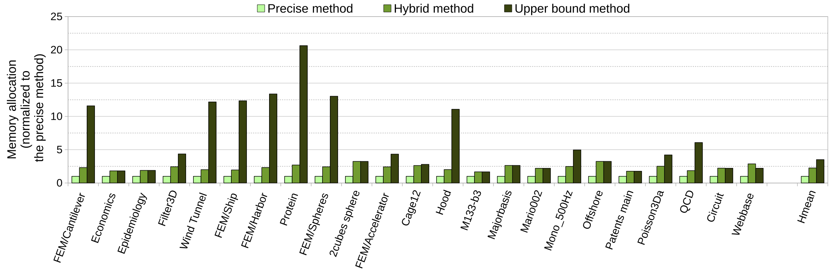
Comparison: C = A² (allocated space)
For matrices with short rows (upper bound size), our hybrid method completely converts to the upper bound method.
For matrices with long rows (upper bound size), our hybrid method allocates much less space than the upper bound method, and be very close to precise method.
In the worst case, our hybrid method needs the largest space, but would not be too bad.
U

Slide 64
Publications
W. Liu, B. Vinter. "A Framework for General Sparse Matrix-Matrix Multiplication on GPUs and Heterogeneous Processors". Journal of Parallel and Distributed Computing (JPDC). 2015.
W. Liu, B. Vinter. "An Efficient GPU General Sparse Matrix-Matrix Multiplication for Irregular Data". 28th IEEE International Parallel & Distributed Processing Symposium (IPDPS '14). 2014.

Slide 65
Conclusions
Faculty of Science

Slide 66
Conclusions
Faculty of Science
Challenge 1. Indirect Addressing
Method: Algorithms for massively parallelism on GPUs (SpMV & SpGEMM)
Challenge 2. Selection of Basic Primitives
Method: Fast segmented sum (SpMV)
Method: Proper primitives for rows of different sizes (SpGEMM)
Challenge 3. Data Decomposition, Load Balancing and Scalability
Method: Evenly decompose A into submatrices of the same #nonzeros (SpMV)
Method: Construct bins containing rows of different sizes (SpGEMM)
Challenge 4. Sparse Output of Unknown Size
Method: Hybrid (upper bound + progressive) memory pre-allocation (SpGEMM)
P
S
U

Slide 67
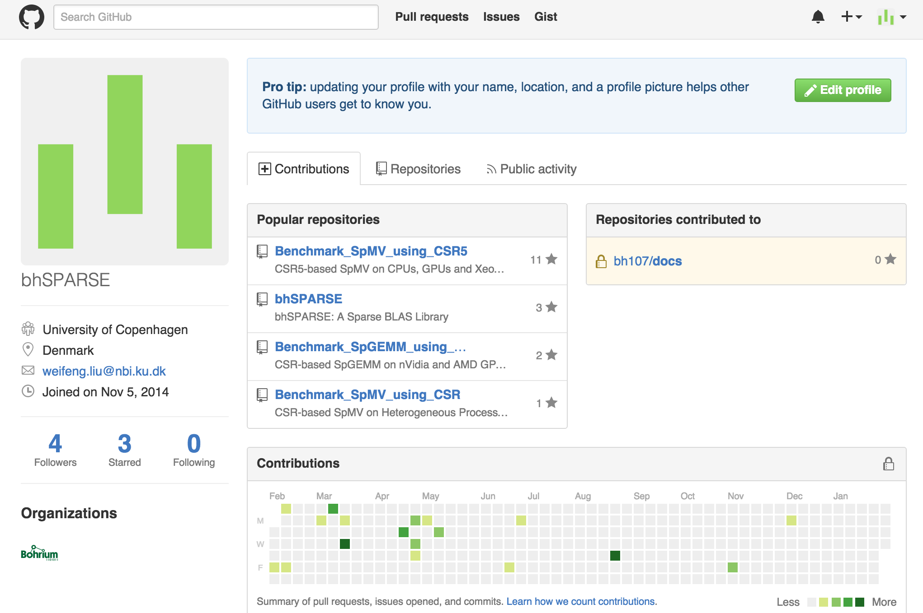
Source Code at Github
http://bhsparse.github.io/bhSPARSE/

Slide 68
T k u !
A y Q s n s ?
0
4
8
9
0
2
4
7
11
12
13

